Slide 1
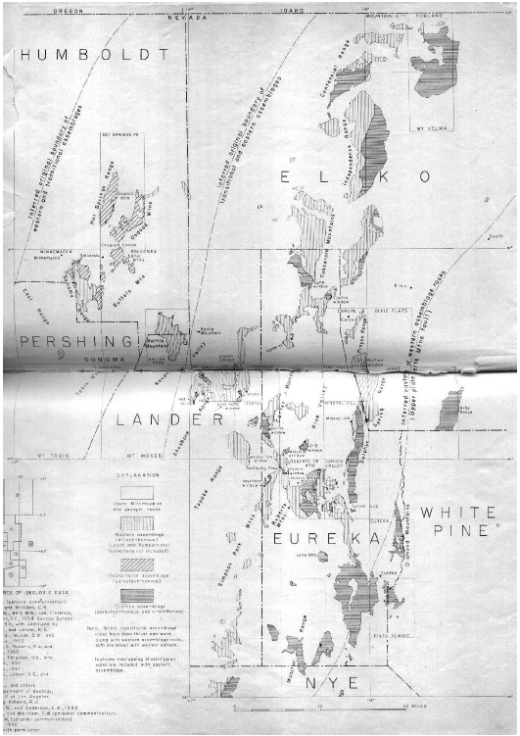
Paleozoic rocks of north-central nevada
Roberts, 1958
Geol 730 Presentation By: Neal Mankins

Slide 2
Purpose
To summarize the stratigraphy of Paleozoic geology in North-Central Nevada
Suggest a synthesis of Paleozoic geochronology
Method
Detailed mapping, stratigraphic & structural analysis by the U.S. Geological Survey & Nevada Bureau of Mines

Slide 3
Background
Three Assemblages- Laid down in a broad north trending syncline until late Devonian
Eastern Assemblage
East of longitude 117
Middle Cambrian to Early Mississippian
~15,000ft thick
Miogeosynclinal limestone and dolomite
Transitional Assemblage
Combination of clastic, volcanic, and carbonate rocks
Found on both the Lower and Upper plate
Western Assemblage
West of longitude 117
Early-Middle Paleozoic
~50,000ft thick
Eugeosynclinal clastic sediments and cherts

Slide 4
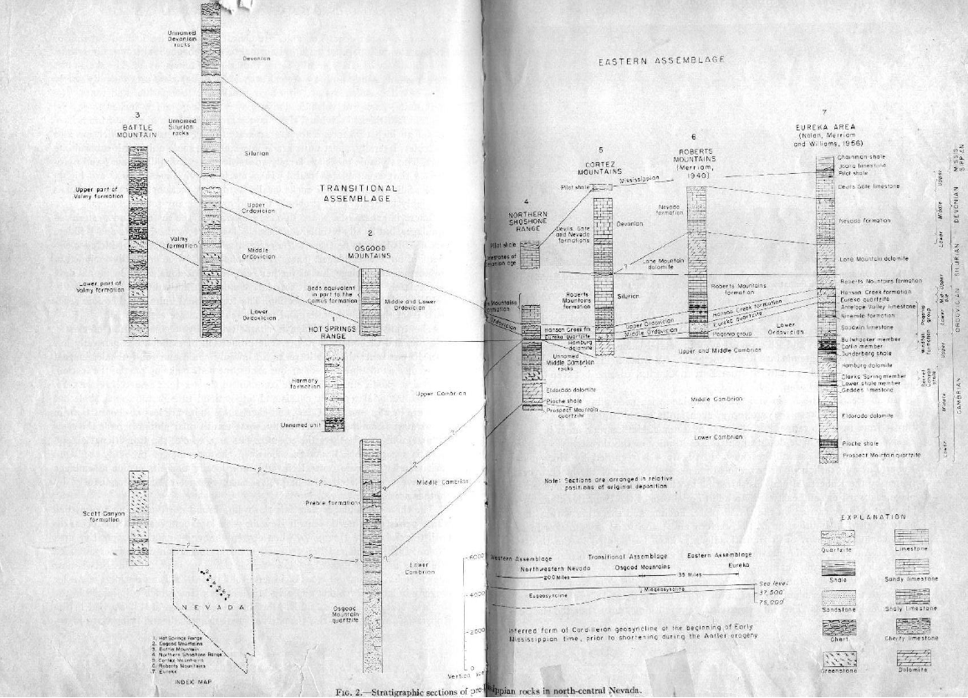
Eastern Assemblage
Mississippian- Pilot shale with interbedded limestone
Devonian- Nevada formation- coarse crystalline limestone 2,000ft thick
Silurian- Roberts Mtn formation- thin bedded platy limestone 750-1,500ft thick
Lone Mtn. Dolomite 2,200ft thick
Ordovician- Pogonip group 350ft of limestone
Cambrian Units- primarily dolomite

Slide 5
Transitional Assemblage
Silurian- calcareous fine-grained sandstone and platy shaly limestone 2,000ft thick
Ordovician
Comus Formation- interbedded shale & chert
Cambrian
Preble Formation- shale & intermediate limestone (Mid Cambrian) ~10,000ft thick
Gradational contact with the Osgood Mtn quartzite
Harmony Formation- feldspathic sandstone (late Cambrian)

Slide 6
Western Assemblage
Devonian- Slaven chert 4,000ft
Silurian- tuffaceous & calcareous shale
Ordovician
Vinini Formation- quartzite, limestone, & sandstone (lower) bedded chert & shale (upper)
Valmy Formation- quartzite (lower) thin bedded chert (upper)
Cambrian
Scott Canyon Formation- thin bedded chert & shale (Cambrian) ~5,000ft thick similar to the Valmy in lithology

Slide 7
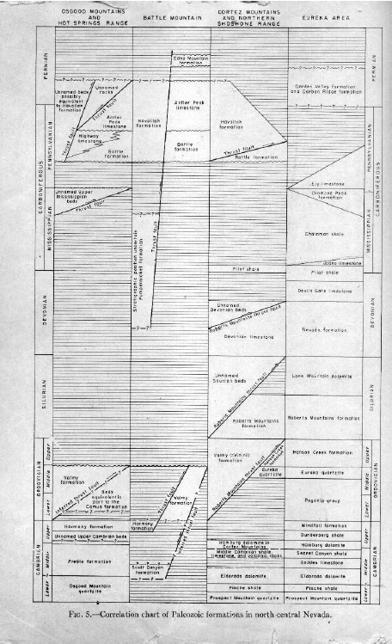
Stratigraphic Windows
Views into the Lower Plate
Roberts Mtn Window- 350ft of limestone (Cambrian-Ordivician) underlies Eureka quartzite (mid Ordivician)
Cortez Window- Eureka quartzite underlain by massive dolomite 800ft thick
Goat Ridge Window- Cambrian volcanics underlain by 300ft of crossbedded quartzite
Lynn Window- Eureka quartzite underlain by massive dolomite 400ft thick

Slide 8
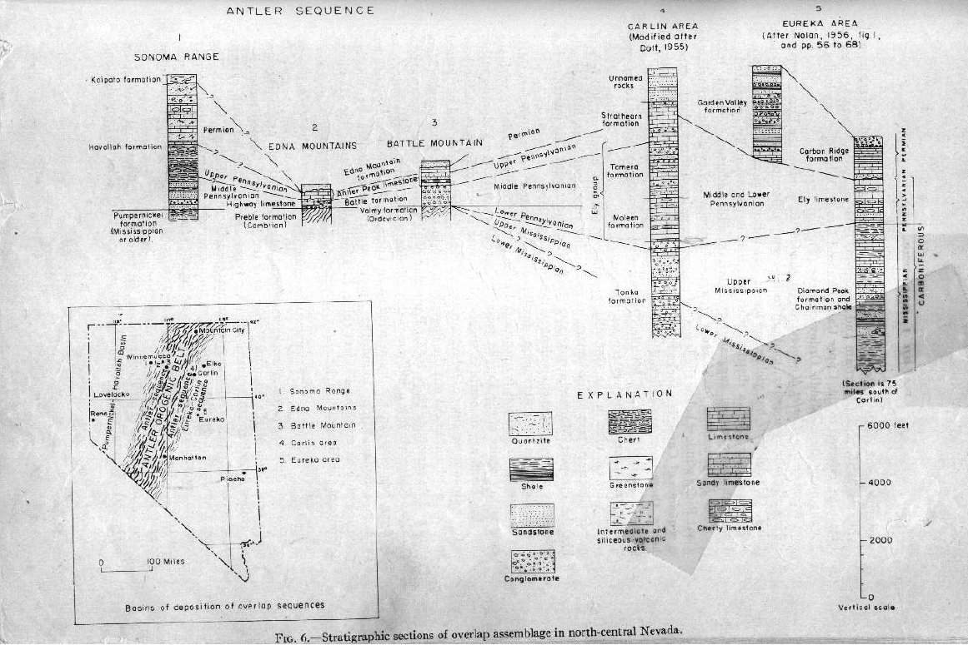
Overlap Assemblage
Devonian Roberts Mtn Thrust
Caused clastic rocks eroded from the rising upland to be shed eastward and westward from the Antler orogenic belt overtop of the eastern, transitional, and western assemblages
In general the overlap sequences are typified of conglomerates which grade into finer conglomerates and sands then silts, clays, and limestones
Eureka-Carlin Sequence
Chainman shale, diamond peak sandstone, Ely limestone, Carbon Ridge conglomerate, & Garden Valley clastics
Antler Sequence
Battle Mountain Formation- conglomerate and interbedded sandstone
Highway Formation- Limestone 200ft thick
Edna Mtn. Formation- fine grained sandstone & dolomitic sandstone

Slide 9
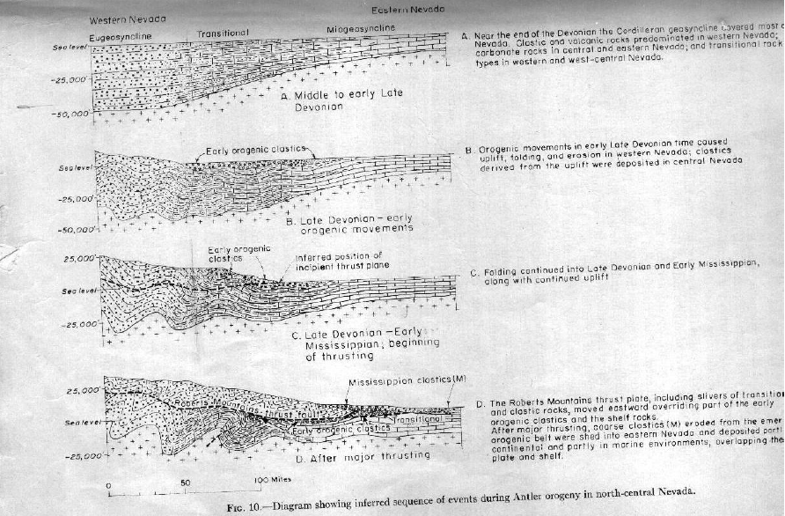
Geochronology
Interpretation
Three Assemblages laid down in broad syncline until late Devonian with the transitional sequence marking the boundary between shallow environments to the East and deeper environments to the West
Roberts Mtn thrust (Late Devonian – Early Mississippian) formed within the Antler Orogenic belt
Late Devonian-Permian coarse clastic rocks were deposited over much of Nevada reflecting regional uplift and erosion

Slide 10
Take Home Points
1. Three Assemblages- Laid down in a broad north trending syncline until late Devonian
Eastern Assemblage
    Miogeosynclinal limestone and dolomite
Transitional Assemblage
    Combination of clastic, volcanic, and carbonate rocks
    Found on both the Lower and Upper plate
Western Assemblage
    Eugeosynclinal clastic sediments and cherts
2. Antler Orogeny & Roberts Mtn. thrust, thrust the Western assemblage over the Eastern assemblage
3. Overlap sequences were deposited as regional uplift and erosion occurred

Slide 11
Stewart, 1980

